Slide 1
Clauses and Phrases
The Basic Units of a Sentence

Slide 2
Phrase
C
A group of related words with no
subject or verb
Examples:
Running through the woods
After a beautiful snowfall
To enjoy the thrilling ride

Slide 3
Clause
A group of related words with a subject and verb

Slide 4
1. Independent Clause
Makes sense all by itself
Can stand alone
Is a simple sentence

Slide 5
Examples:
Julia liked eating hamburgers and French fries.
The play was funny.
I missed the big game.

Slide 6
2. Dependent Clause
Does not express a complete thought
Cannot stand alone
Introduced by a dependent word

Slide 7
Dependent words
Page 484 in textbook
after before if unless
although while until
Who which that

Slide 8
Examples:
Although Julie liked eating French fries
Because the play was funny
After I missed the big game

Slide 9
Practice:
DC, IC, or Phrase?
Because I was sick and missed the game
Please, eat your supper!
Stop!
After a great evening
When Harry and Sally were young

Slide 10
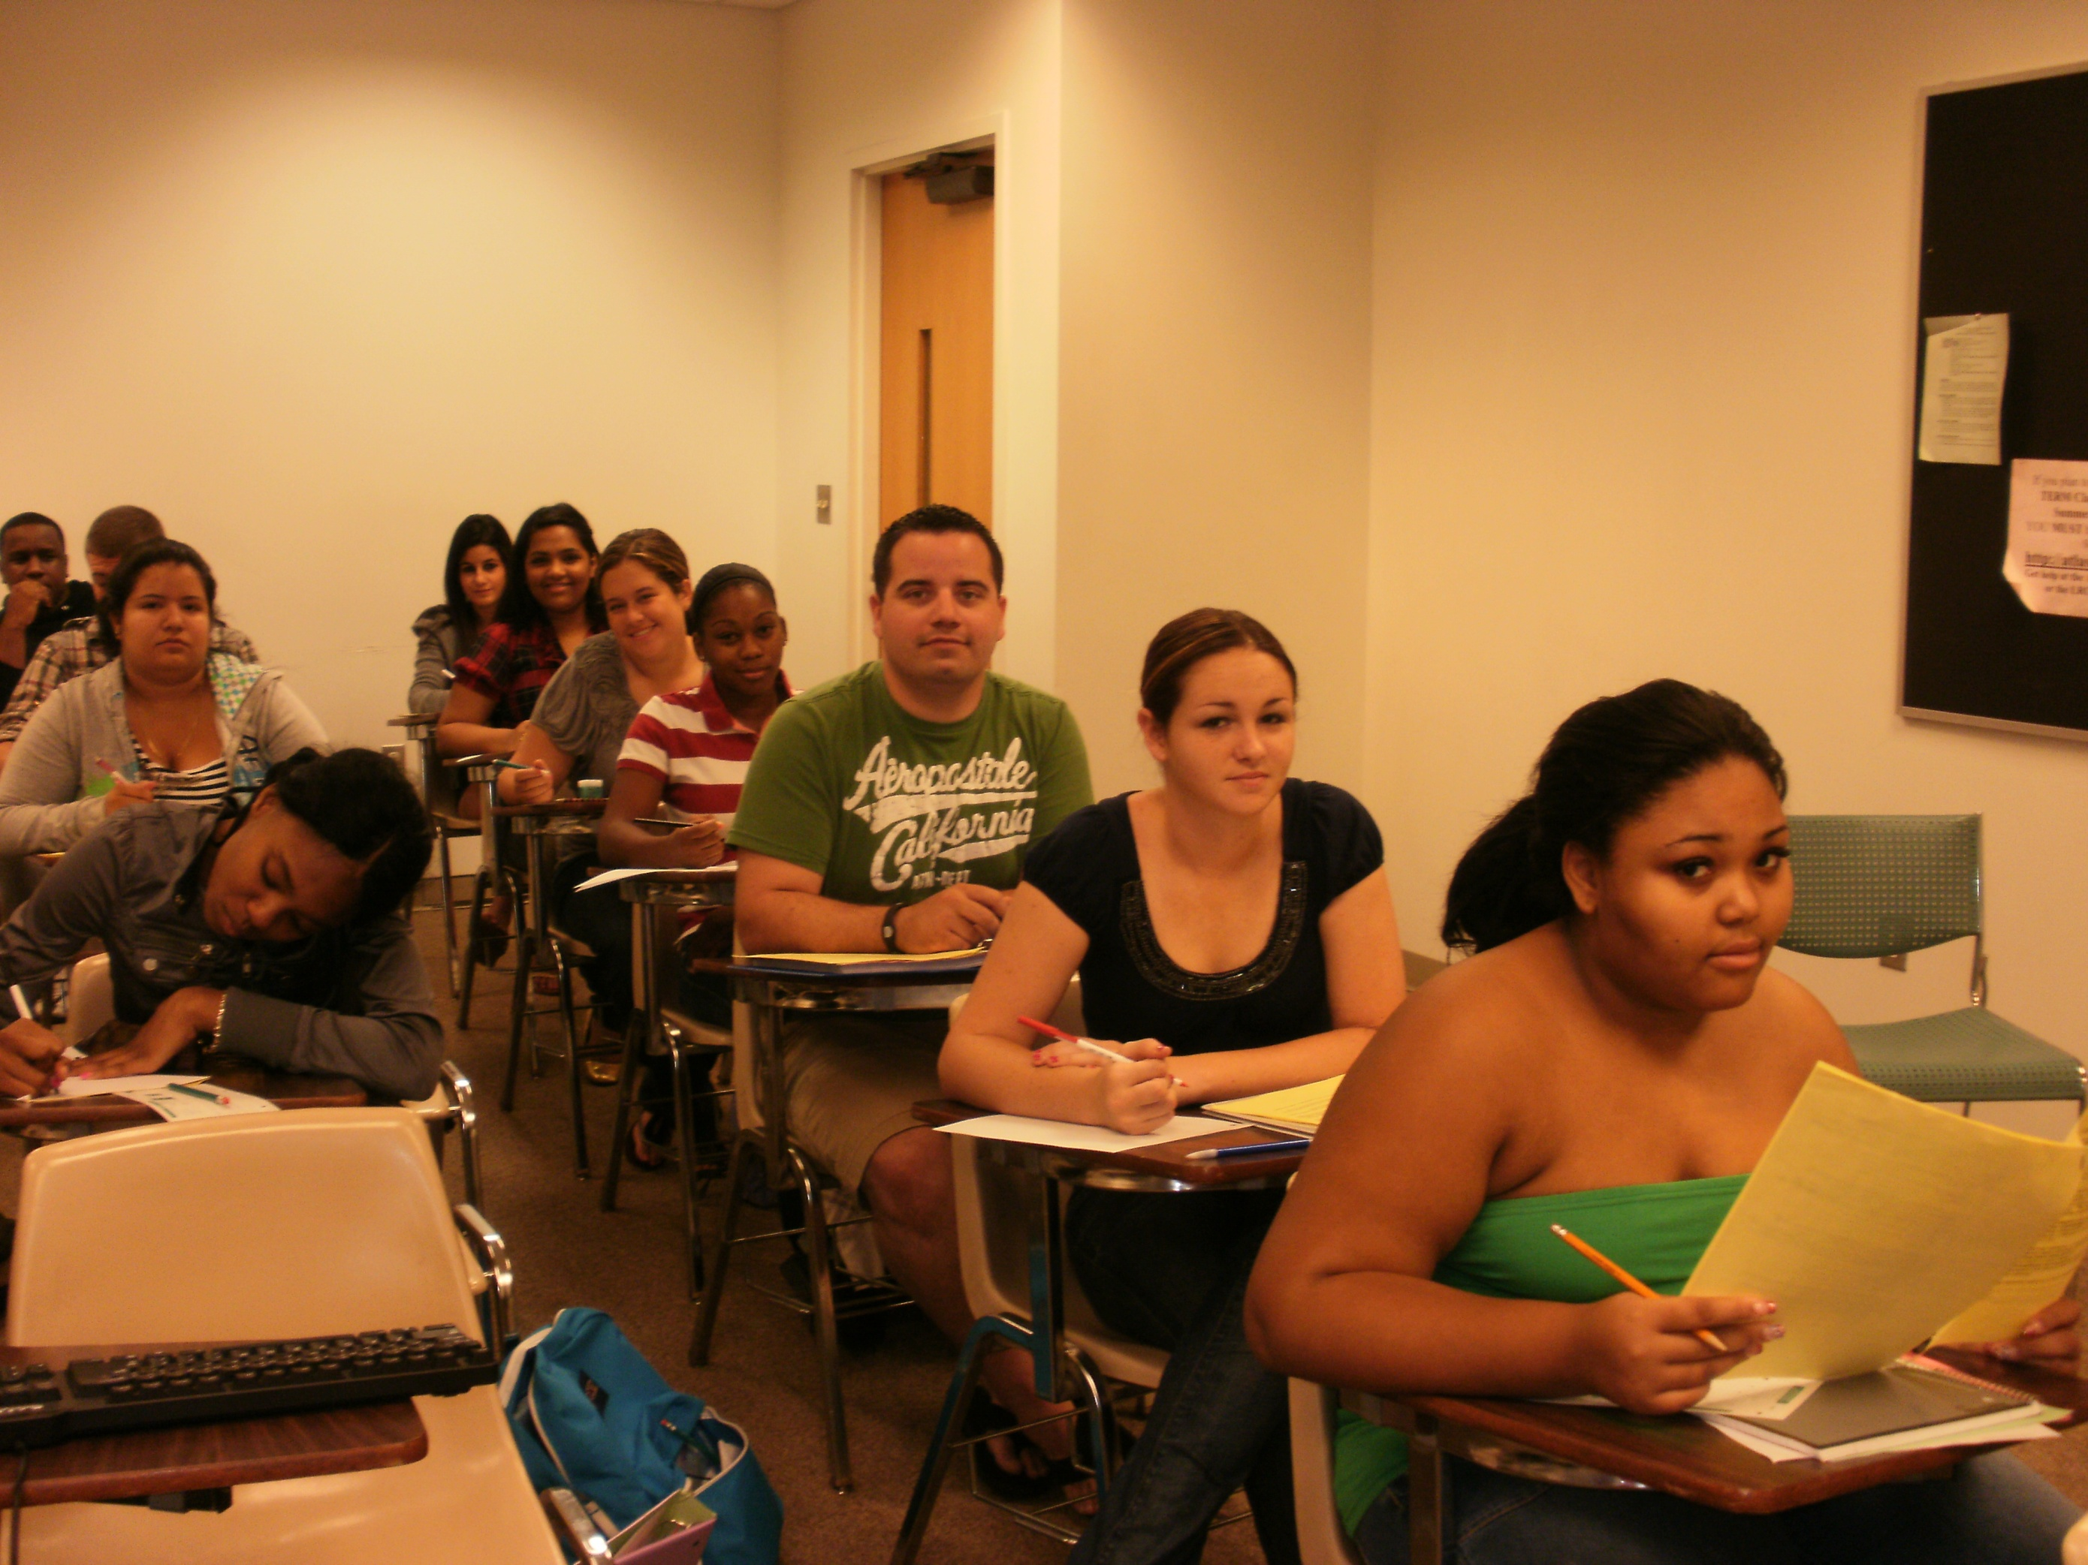

Slide 12
